Slide 1
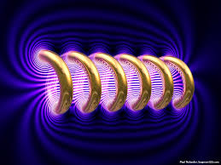
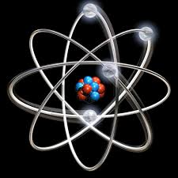
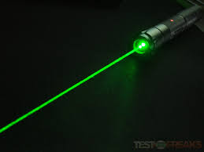
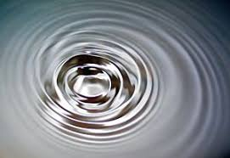
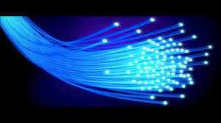
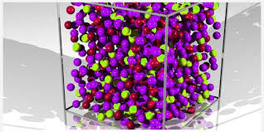
Engineering Physics
PHY-109
Waves-1
ELECTROMAGNETIC THEORY
QUANTUM MECHANICS
LASER
WAVES
Dr. Jeeban Pd Gewali
Department of Physics
Lovely Professional University
Phagwara, Punjab-144411
SOLID STATE PHYSICS
FIBER OPTICS

Slide 2
Syllabus
Interference phenomenon and Concept of resonance
Audible, ultrasonic and infrasonic waves. Production of ultrasonic waves by magnetostriction method.
Production of ultrasonic waves by piezoelectric method, ultrasonic transducers and their uses, applications of ultrasonic waves, detection of ultrasonic waves (Kundt's tube method, sensitive flame method and piezoelectric detectors),
Absorption and Dispersion of ultrasonic waves.
Superposition of two waves, sound wave and its velocity, standing waves, Formation of beats, Supersonic and shock waves.

Slide 3
Wave Motion
Awave is the propagation of disturbance in a medium which carries the energy along with its motion.
Wave can be mainly of three types
Mechanical
Electromagnetic
Matter wave
The equation governing the propagation of disturbance in a classical wave is
$$\frac{∂^{2}f}{∂x^{2}}=\left(\frac{1}{υ^{2}}\right)\frac{∂^{2}f}{∂t^{2}}$$
In general wave motion is propagating, however there are waves in which, over a period of time no net energy is carried in any direction. These are called the stationary waves.
The shape of the wave can vary widely depending on the situation. A short and sharp jerk to the free end of a string anchored to the wall at the other end, creates a hump to propagate through the string. Such a wave is called a pulse.
Classical Waves
Non Classical Waves

Slide 4
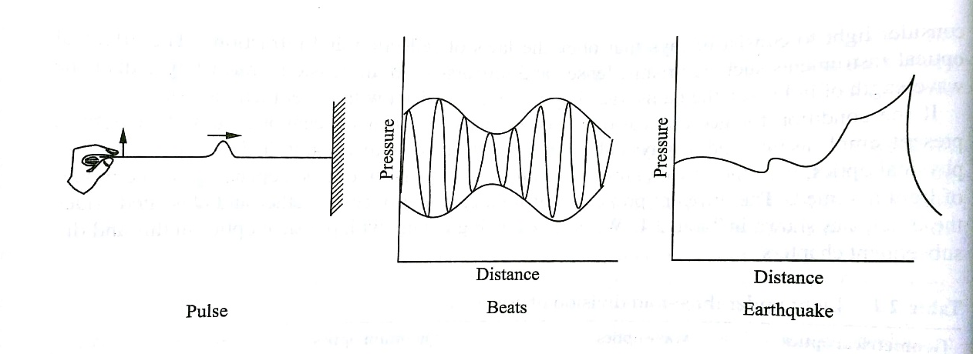
Wave Motion
If two sound waves of slightly different frequencies mix with each other, the resulting profile is called beats.
Again, the wave of an earthquake may have a very complicated profile of pressure as shown in the figure.
$$\frac{∂^{2}f}{∂x^{2}}=\left(\frac{1}{υ^{2}}\right)\frac{∂^{2}f}{∂t^{2}}$$
Wave Equation in Differential Form
The simplest function which is the solution of the wave equation is
$$f=A sin⁡(k\left(x−υt\right)+φ)$$
** It can be easily shown that this solution satisfies the differential equation by integrating it twice with respect to space (x) and time (t).

Slide 5
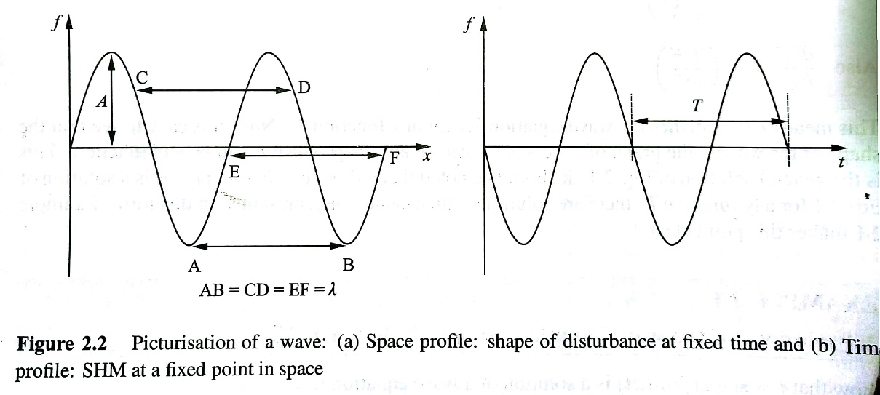
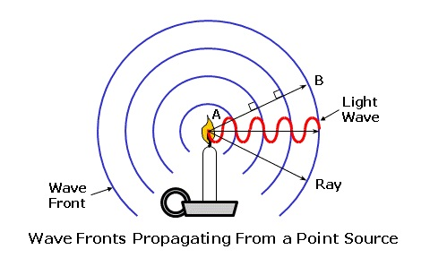
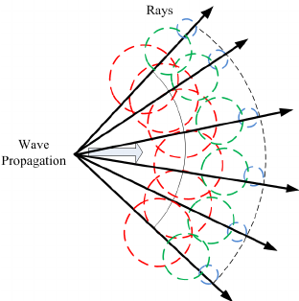
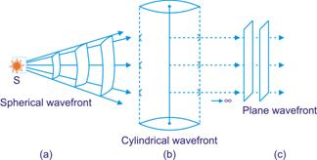
Wave Motion
$$\frac{∂^{2}f}{∂x^{2}}=\left(\frac{1}{υ^{2}}\right)\frac{∂^{2}f}{∂t^{2}}$$
$$f=A sin⁡(k\left(x−υt\right)+φ)$$
Amplitude: The maximum size of the disturbance is known as the
Amplitude (A).
Phase Angle: The argument of the function on the right hand side is known as the phase of the disturbance. It is expressed either in degrees or in radians. The constant $φ$ is called the initial phase.
Wave front: A wave front is defined as the locus of the points which are in the same phase. According to Huygens's theory, each point on a wave front acts as a source of secondary disturbance. The waves emanating from these secondary sources are known as the wavelets. Thus,
Point source Spherical Wave Front
Line Source Cylindrical Wave Front
Plane Source Plane Wave Front

Slide 6
Wave Motion
Wave length: It is the distance the wave has to travel along the direction of propagation to change the phase by $2π$. It is usually denoted by $λ$. It is the normal distance between two consecutive wave fronts of the same phase i.e. whose phase differ by $2π$.
Time Period: It is the time required for the wave to travel a distance of one wavelength so that
$$λ=υT$$
Frequency: The quantity 1/T is called the frequency. It represents the number of cycles completed per second.
$$ν=\frac{1}{T}$$
Angular Frequency: It represents the radian angle change in the phase of the wave per second.
$$ω=2πν$$
Wave Number and Wave Vector: The is the spatial frequency of a wave, either in cycles per unit distance or radians per unit distance. It can be envisaged as the number of waves that exist over a specified distance.
Wave number is the magnitude of the wave vector (k).
Thus,
$$k=\frac{2π}{λ}$$
Velocity: The velocity or the phase velocity of a wave is defined as the velocity of its wave fronts. Let the wave front move a distance $Δx$in time $Δt$.
Then,
$$φ\left(x,t\right)=φ(x+Δx, t+Δt)$$
Therefore,
$$υ=\frac{Δx}{Δt}=\frac{ω}{k}=νλ$$

Slide 7
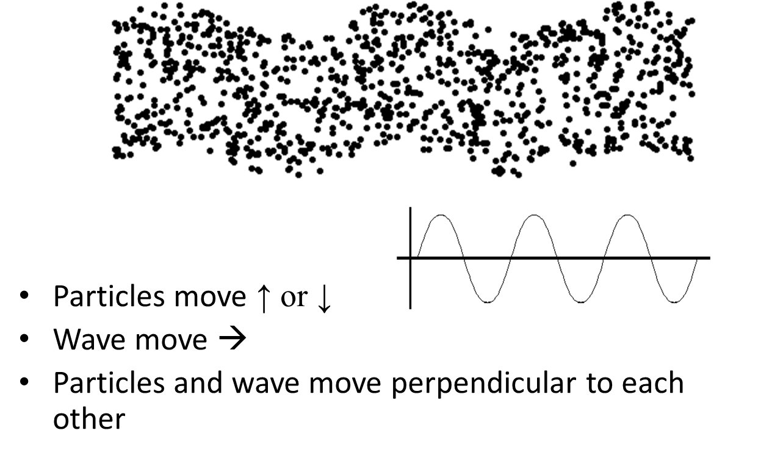
Mechanical Wave: Transverse Wave
Examples
Light waves
Waves on a string
Slinky waves
Television waves
microwaves

Slide 8
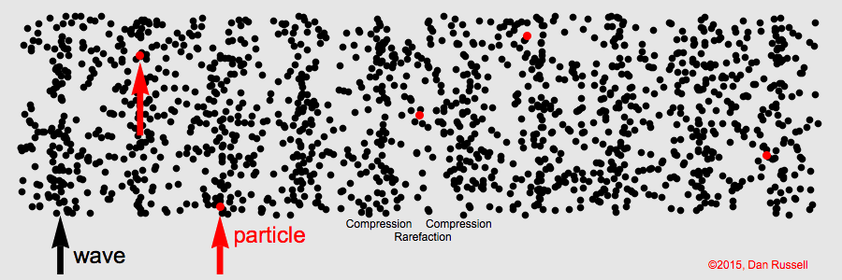
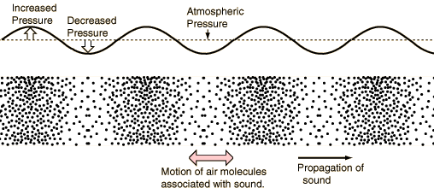
Mechanical Wave: Longitudinal Wave
In a longitudinal wave the particle displacement is parallel to the direction of wave propagation. The animation at right shows a one-dimensional longitudinal plane wave propagating down a tube. The particles do not move down the tube with the wave; they simply oscillate back and forth about their individual equilibrium positions. Pick a single particle and watch its motion. The wave is seen as the motion of the compressed region (i.e., it is a pressure wave), which moves from left to right.
The animation shows the difference between the oscillatory motion of individual particles and the propagation of the wave through the medium. The animation also identifies the regions of compression and rarefaction.
SOUND WAVES
P-Wave (Primary) wave in earthquake is
An example of longitudinal wave.

Slide 9
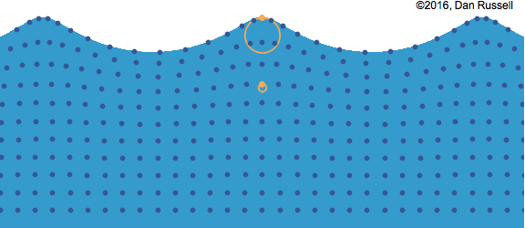
Water Surface Waves
Water waves are an example of waves that involve a combination of both longitudinal and transverse motions. As a wave travels through the waver, the particles travel in clockwise circles. The radius of the circles decreases as the depth into the water increases. The animation at right shows a water wave travelling from left to right in a region where the depth of the water is greater than the wavelength of the waves. I have identified two particles in orange to show that each particle indeed travels in a clockwise circle as the wave passes.

Slide 10
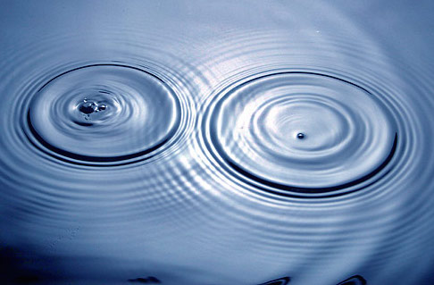
Interference
While material particles such as rock will not share its space with another rock, more than one vibration or wave can exist at the same time in the same space.
When more than one wave occupies the same space at the same time, the displacements add at every point. This is called the principle of superposition of waves.
If we drop two rocks in water simultaneously, maintaining a certain definite distance, then the water waves generated thereby overlap with each other and creates a pattern called the interference.
Within the zone of interference, wave effects may be increased, decreased or neutralized based on the fact whether the interference is constructive or destructive.
Wave interference occurs throughout physics, from mechanical waves to light waves and even with the quantum-mechanical waves that describe matter at the atomic scale.
Zone of Interference
Created by the superposition
of waves

Slide 11
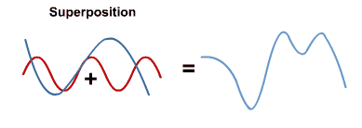
Interference

Slide 12
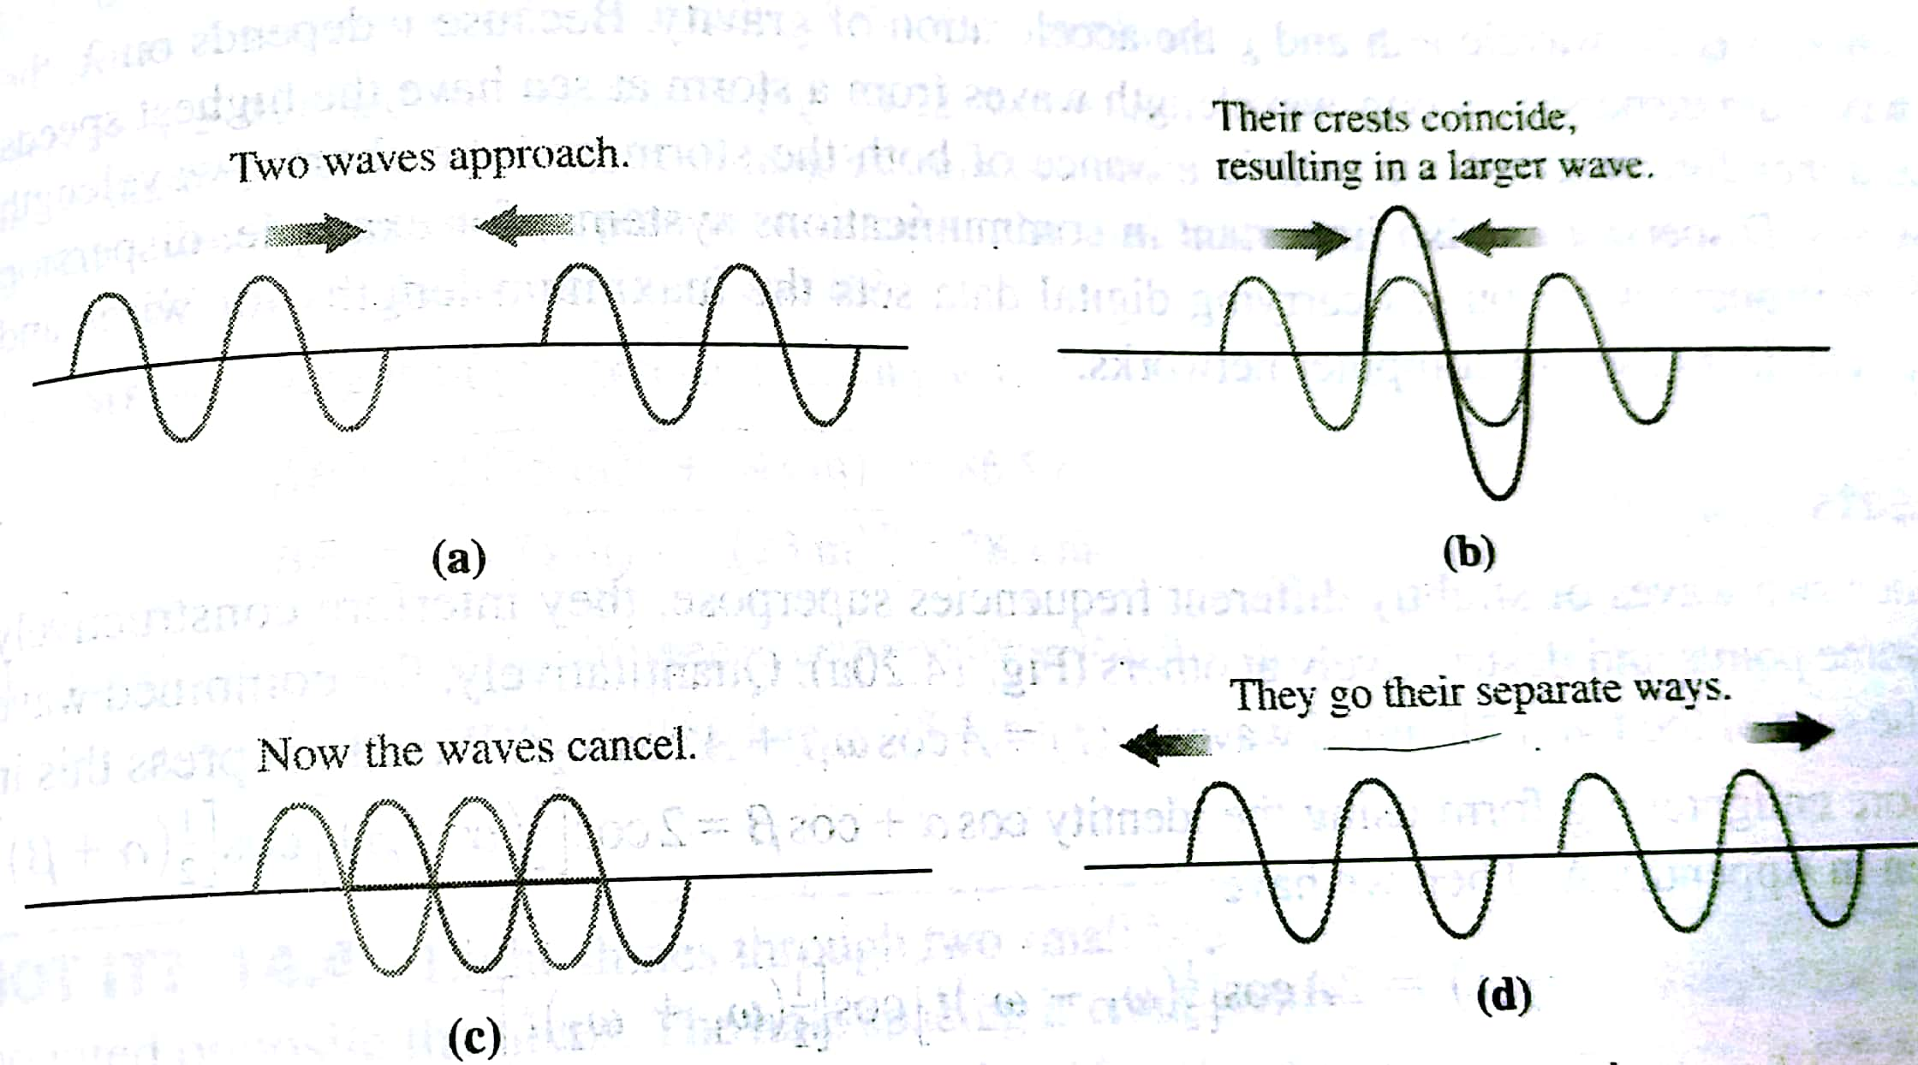
Interference
Let us consider, there are two waves approaching each other, shown in fig (a).
As shown in the figure (b), the wave crests coincide and so do the troughs. The resulting wave is momentarily twice as big. This is called the constructive interference-two waves superposing to produce larger wave displacements.
In figure (c) the crest of one wave meets the trough of another wave. As a result they cancel each other and the resulting amplitude is zero. This is called the destructive interference.

Slide 13
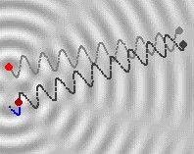
Path Difference and Phase Difference
Let's assume that, two stones are thrown at two points which are very near, then you will see the pattern as shown in the figure.
let's mark the first point of disturbance as S1 and the other as S2, then waves will be emanated as shown above. By having a cross-sectional view, you will see the same waves as shown in the figure below (in the below explanation wavelengths of waves emanated from two different disturbances is assumed to be the same).
The waves emanating from S1 has arrived exactly one cycle earlier than the waves from S2. Thus, we say that, there is a path difference between the two waves of about λ (wavelength). If the distance traveled by the waves from two disturbance is same, then path difference will be zero. Once you know the path difference, you can find the phase difference using the formula given below:
$$Phase Difference=\left(\frac{2π}{λ}\right)×Path Difference$$

Slide 14
Interference of waves going in the same direction
Suppose two identical sources send sinusoidal waves of same angular frequency $ω$ in the positive x-direction. The wave velocity and the wave number is same for the two waves.
One source may be started a little later than the other or the two sources may be situated at different points. Thus, the two waves arriving at a point differ in phase. Let A1 and A2 be the amplitudes of the two waves and $δ$ be the difference in phase angle.
The two waves are then represented by the equation
$$y_{1}=A_{1}sin⁡(kx−ωt)$$
$$y_{1}=A_{2} sin⁡(kx−ωt+δ)$$
According to the principle of superposition, the resultant wave is
$$y=y_{1}+y_{2}$$
Applying, $\sin\left(A+B\right)=sinA\cos{B}+\cos{A}\sin{B}$ we get,
$$y=A_{1}\sin\left(kx−ωt\right)+A_{2}\left[\sin\left(kx−ωt\right)\cos\left(δ\right)+\cos\left(kx−ωt\right)\sin\left(δ\right)\right]$$
$$y=\sin\left(kx−ωt\right)\left(A_{1}+A_{2}cosδ\right)+cos⁡(kx−ωt)(A_{2}sinδ)$$
If we write
$A_{1}+A_{2}cosδ=A\cos{(ε)} and A_{2}sinδ=A\sin{(ε})$
Then we get,
$$y=A\left[\sin\left(kx−ωt\right)\cos\left(ε\right)+cos\left(kx−ωt\right){sin\left(ε\right)}\right]$$
$$y=A sin⁡(kx−ωt+ε)$$

Slide 15
Interference of waves going in the same direction
Thus the resultant is indeed a sine wave of amplitude A and with a phase difference $ε$ with the first wave. Thus,
$$A^{2}=A^{2}\cos^{2}{ε}+A^{2}\sin^{2}{ε}$$
$$A^{2}={\left(A_{1}+A_{2}cosδ\right)}^{2}+{\left(A_{2}sinδ\right)}^{2}$$
$$A^{2}=A_{1}^{2}+A_{2}^{2}+2A_{1}A_{2}cosδ$$
$$A=\sqrt{A_{1}^{2}+A_{2}^{2}+2A_{1}A_{2}cosδ}$$
Also ,
$$\tan{ε=\frac{A sinε}{A cosε}=\frac{{(A}_{2}\sin{δ)}}{A_{1}+A_{2}\cos{δ}}}$$

Slide 16
Condition for Constructive and Destructive Interference
Constructive Interference:
The resultant amplitude is maximum when $cosδ=+1$.
Thus, $δ=2nπ$.
This implies $A=A_{1}+A_{2}$
Destructive Interference:
The resultant amplitude is minimum when $cosδ=−1$.
Thus, $δ=(2n+1)π$.
This implies $A=|A_{1}−A_{2}|$

